Slide 1

Emotions Recognition In a Video Stream
João Gomes
Data Science Retreat
Notes:
This presentation is about recognizing emotions in a live video stream

Slide 2
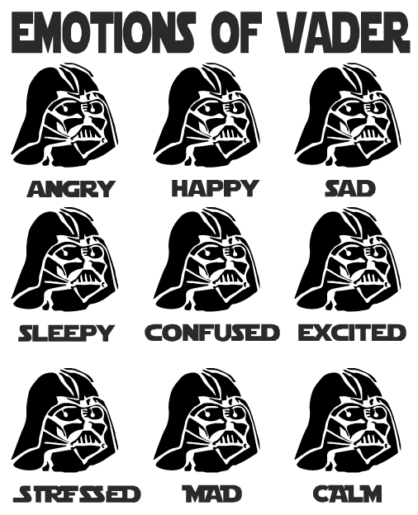
How to recognize emotions?
Notes:
How do we recognize emotions? There’s their actions and sounds, but also the expression on people’s faces. This however, is not so easy. As a very popular character in popular culture, Vader became an icon for someone who is hard to read how he is feeling at any given moment.

Slide 3
Live Demo
Model is small enough to be able to use in real time.
Using OpenCV to detect faces.
Needs a bit of exaggeration to get the detection just right.
Notes:
(open the jupyter notebook to test the model)

Slide 4
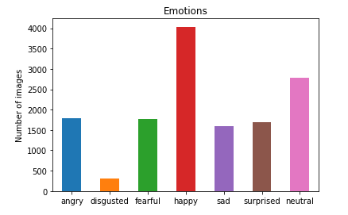
Dataset
Using a dataset to train:
fer2003
Started with 36k but removed images until I had 14k forward looking faces
Notes:
This dataset is not very well balanced, there are a lot of pictures for the happy and neutral faces, but almost none for disgusted. But we do have a lot of images in general (14 thousand), which is very nice to train a neural network from scratch.

Slide 5
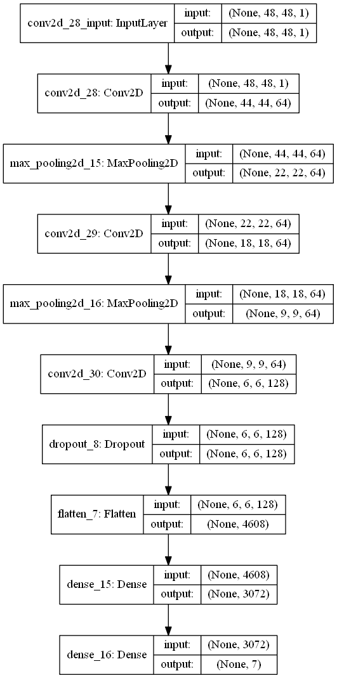
Convolutional Neural Network
Keras with tensorflow backend
Best model:
3 convolutional layers , filter size (5x5)
max pooling layers, size (2x2)
2 dense layers, size first layer (3072)
Used dropout method to regularize.
Tested models with between
2 million and 14 million
parameters.
Notes:
I used a convolutional neural network model to recognize the emotions. Using 3 convolutional layers and max pooling layers, it learns how interpret the patterns in the face that are most expressive and are activated when we feel something. The dense layers at the end pick and choose from these which ones correspond to each emotion and are where almost all parameters are. The input is 48 by 48 pixels (grayscale) and the last dense layer output will give us our emotion (size 7)

Slide 6
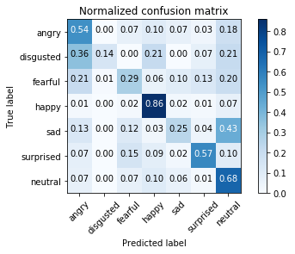
Results
Accuracy is 61% (research papers for this dataset is 70%)
Notes:
I believe I got a good result, but it could indeed be better. It turns out that the dataset was not very well labeled to start with, as can could be seen by the research papers associated with it. Still, the happy emotion is the easiest to detect, since you practically only need to smile and it will return happy. Disgusted is the most hard to detect, because of how little pictures we had to begin with for training. Fearful and Sad because of mislabeled data, I believe. Or just hard to separate them to begin with.

Slide 7
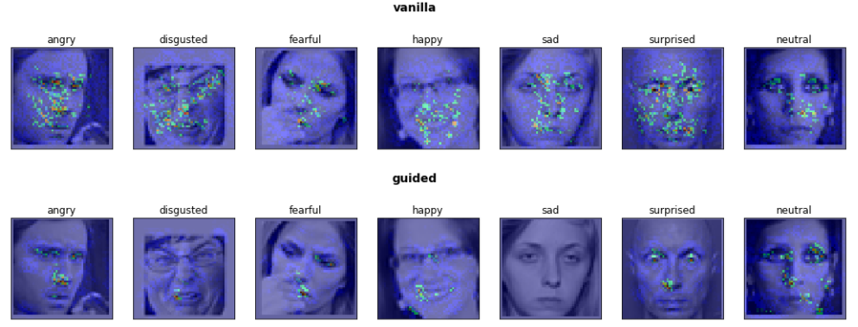
Feature Visualization
How does our CNN distinguish between the emotions?
Notes:
How does our model see our pictures? What parts of each face are important for the classification it gives? I used a saliency map, with and without guided backpropagation. This algorithm tries to maximize the output of each emotion per picture. Basically, what could we change in each image to improve the score. As we can see, it looks all over the face but on the bottom row we can see which areas are the most important. The happy one is the smile, Surprised looks at the white of the eyes, Angry goes for the nose and upper face, Neutral is all over the place. Note how it doesn’t care about the hand in front of the mouth for Fearful.

Slide 8
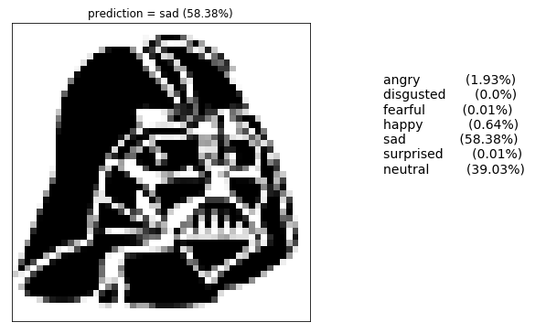
Closing
Github project:
https://github.com/GomesJP/Emotions-Recognition
Notes:
Here is my github project, you can download and train your own model. And here is my model’s prediction of Vader’s emotion. He seems rather sad, pending to neutral ☺
More and better data! Seems obvious, but the dataset is not very well labeled.
Different model. There are more recent models being tested in academia.
More data preprocessing. Like rotating the face to be face forward before using as input to the CNN.
Balancing the classes (more faces are happy and neutral, disgust is a very small set).

